Slide 1


Get Started with MySQL and MySQL Workbench (MySQL 8 version)
CSC134
Dr. Haiquan (Victor) Chen

Slide 2
Software
Download and install (1) MySQL server and (2) MySQL Workbench (GUI)
The link is here:
https://dev.mysql.com/downloads/windows/installer/

Slide 3
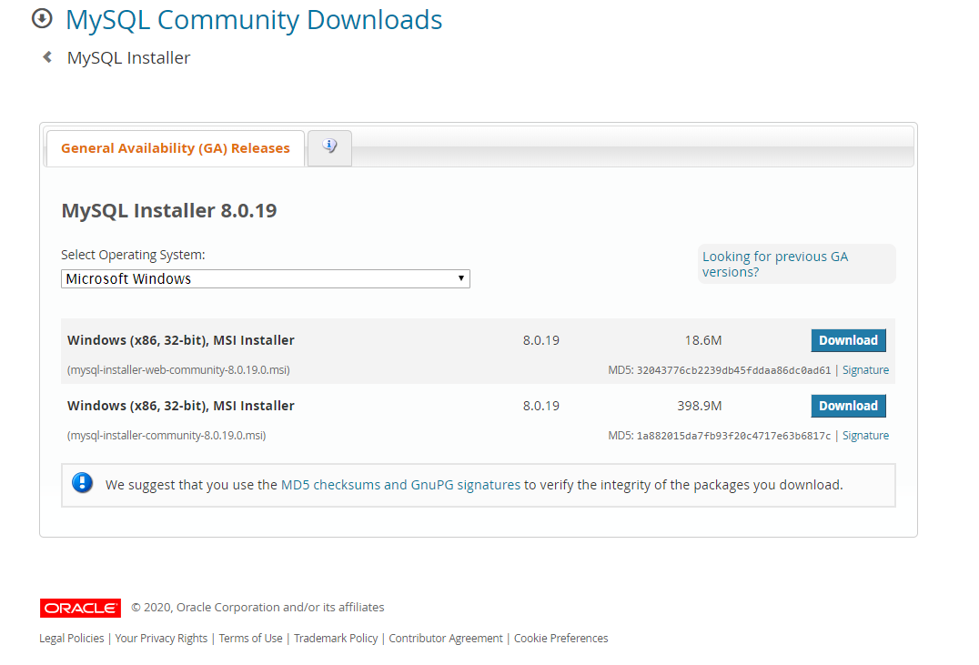
Download Installer

Slide 4
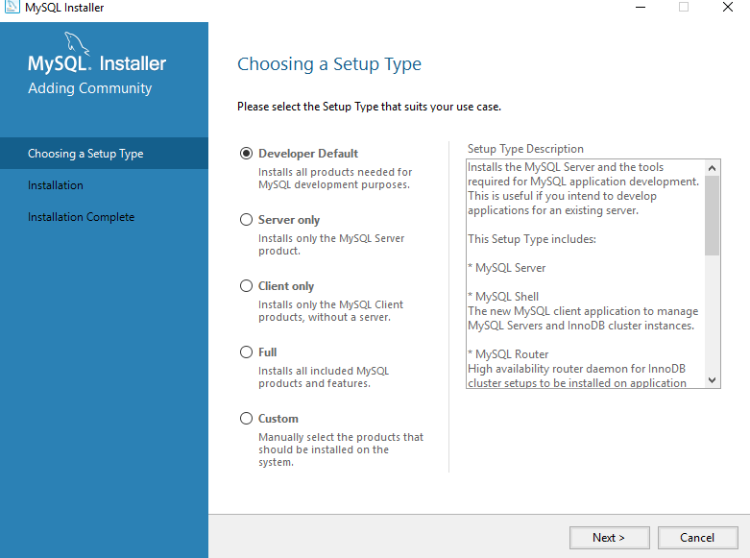
Choose Developer Default

Slide 5
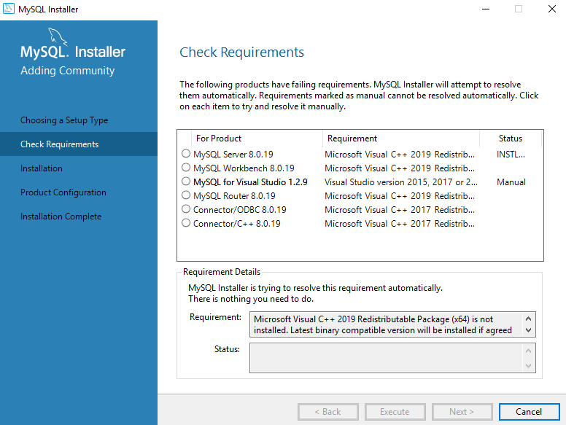
Check requirements automatically

Slide 6
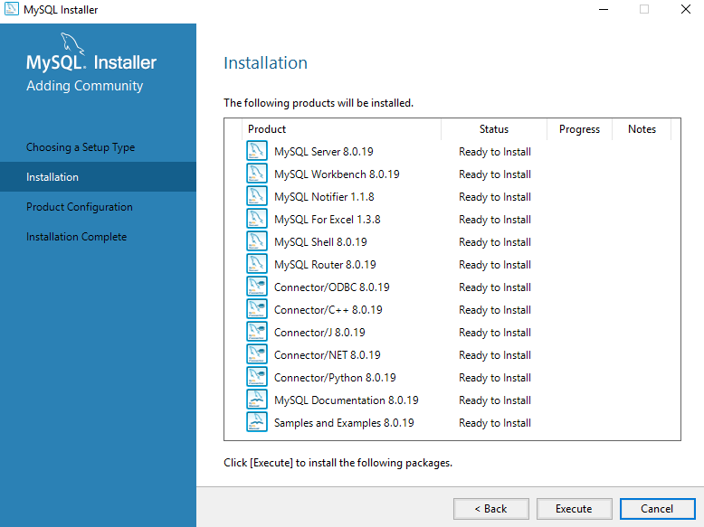
Click Execute

Slide 7
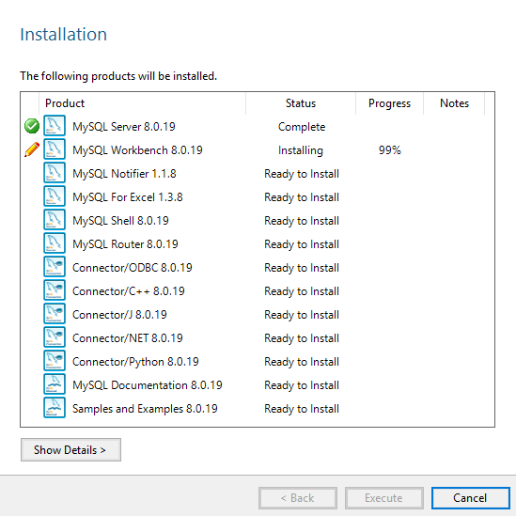
Install MySQL Server and Workbench at minimum

Slide 8
Make sure…
Your installation should include both (1) MySQL server and (2) MySQL Workbench

Slide 9
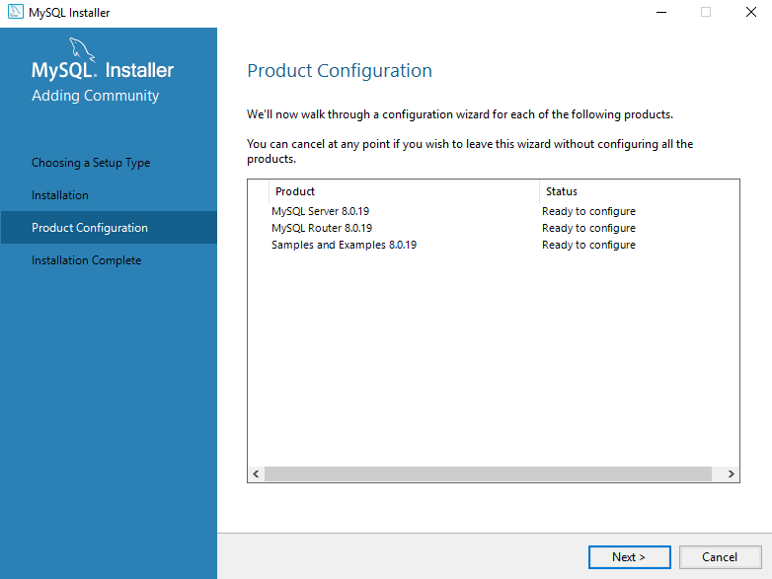

Slide 10
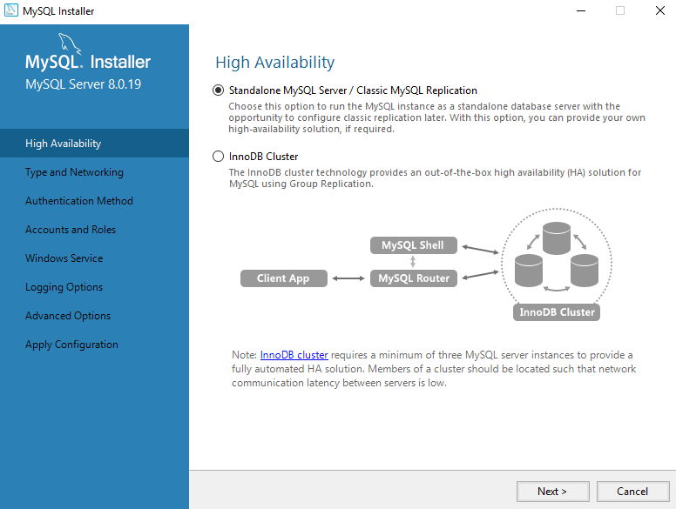
Configure MySQL server

Slide 11
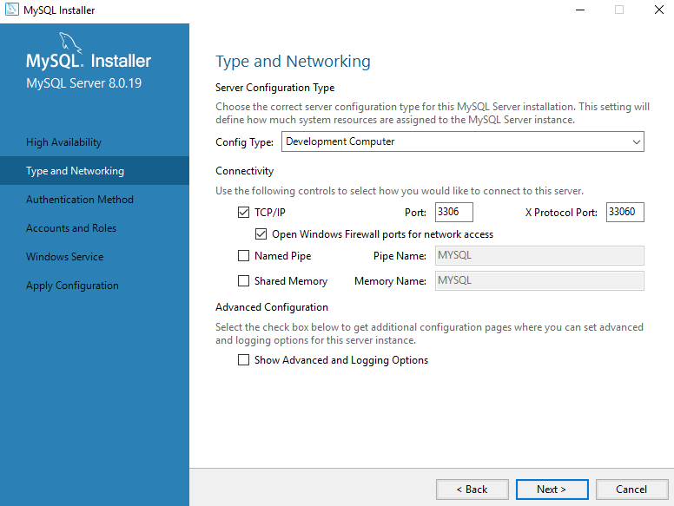
Go with Default Networking Setting

Slide 12
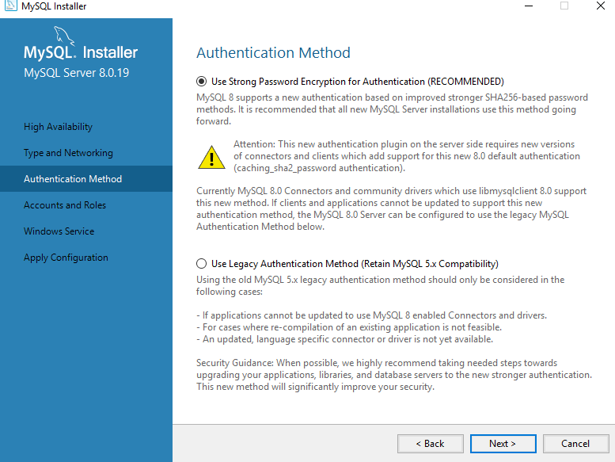
Go with Authentication Setting

Slide 13
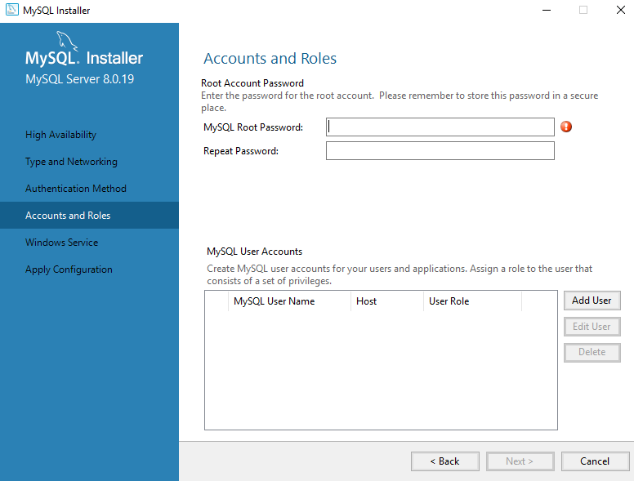
Set up Your Root Password

Slide 14
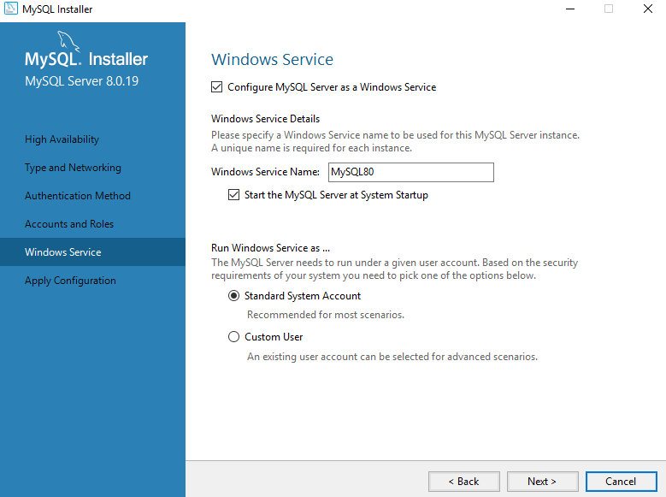
Set up MySQL as service

Slide 15
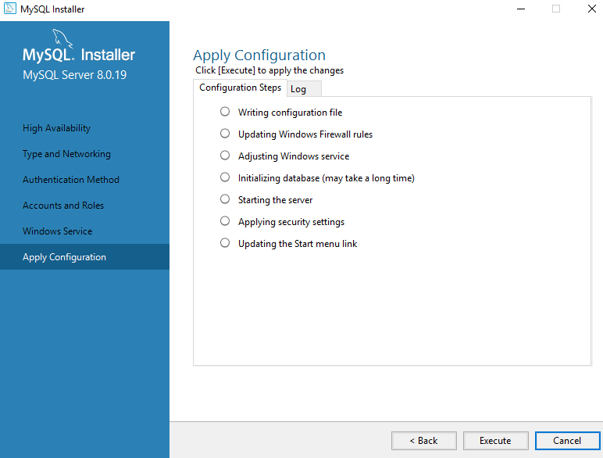
Apply configuration by clicking “Execute”

Slide 16
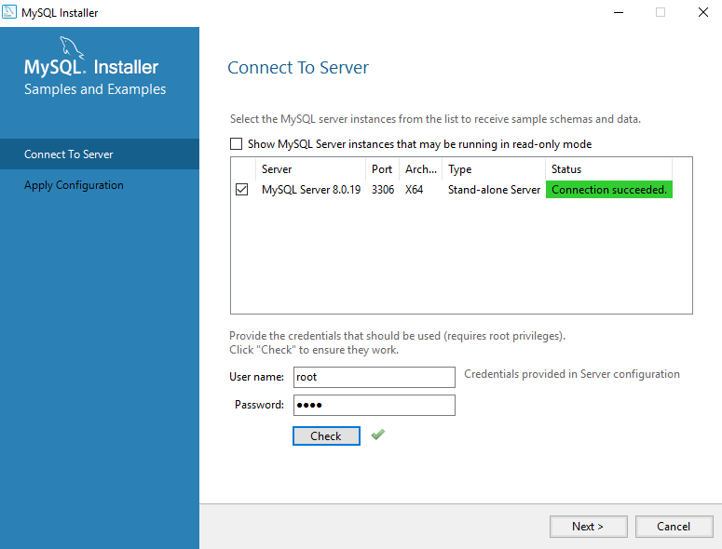
Check connection to server

Slide 17
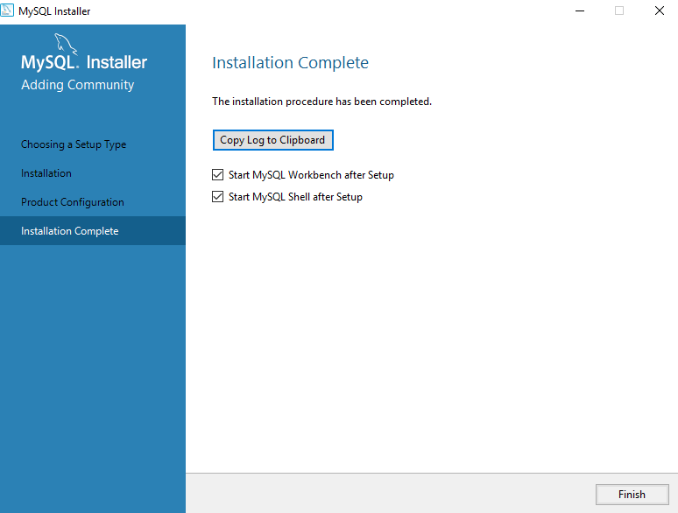
Complete

Slide 18

Done!

Slide 19
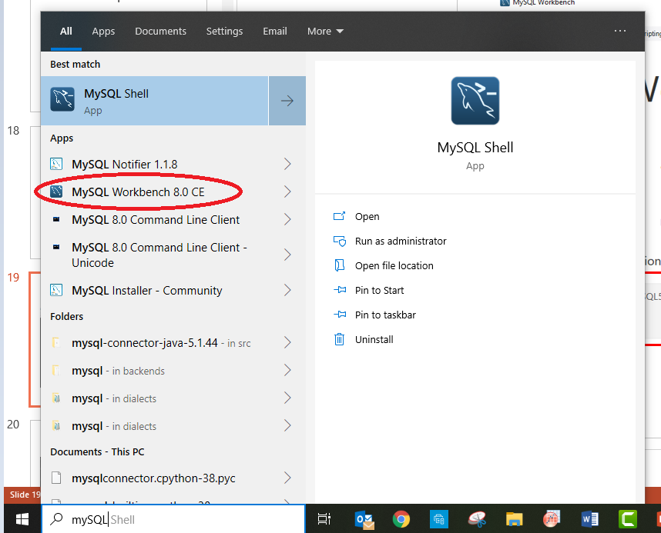
Go to Start Menu

Slide 20
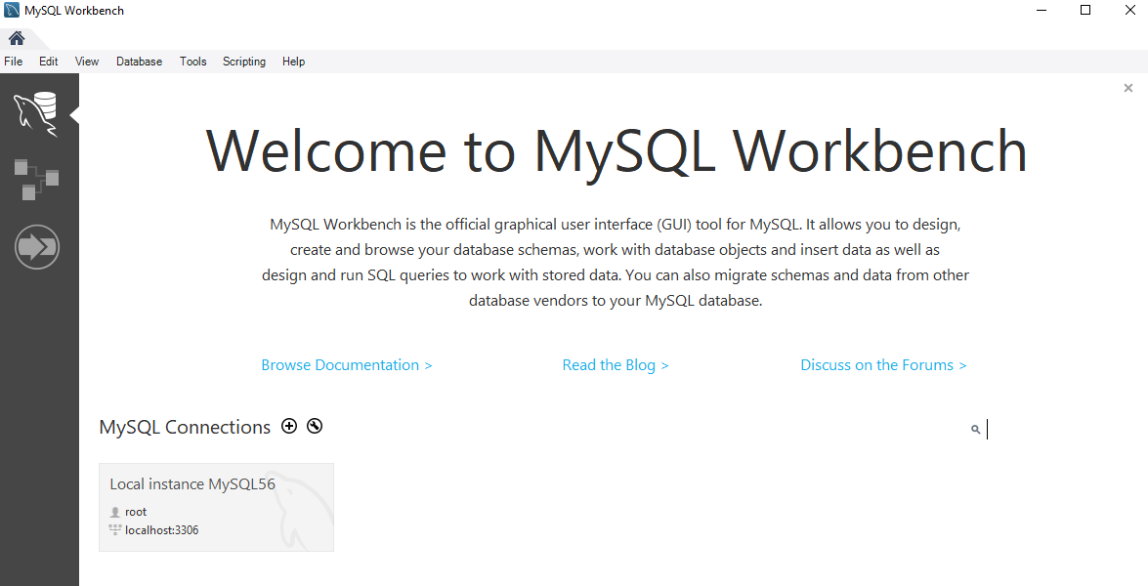
Connect to MySQL server

Slide 21
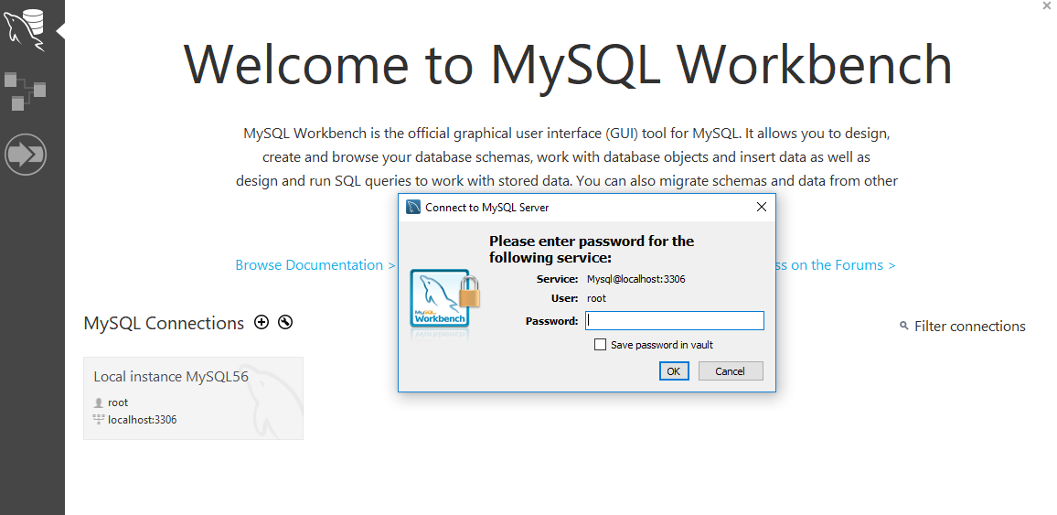
Connect to MySQL server

Slide 22
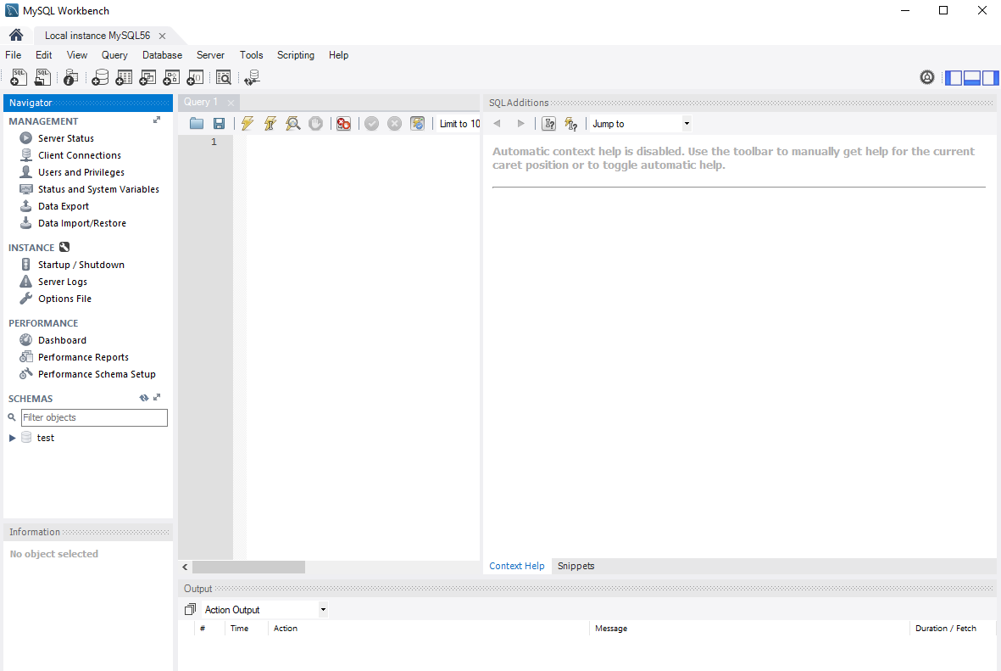
Editor interface should pop up…

Slide 23
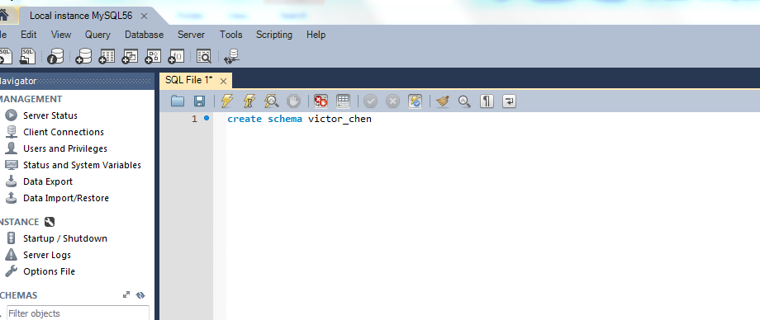
Create your DB

Slide 24
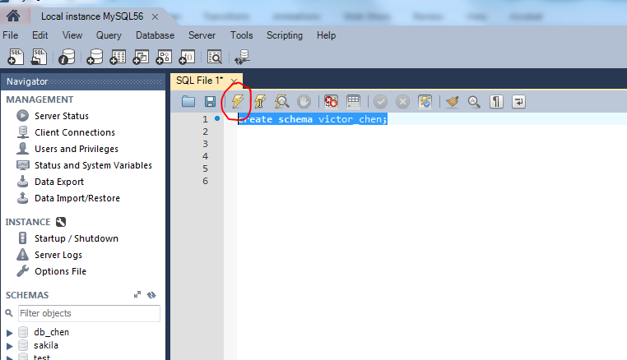
Run the selected SQL statement…

Slide 25
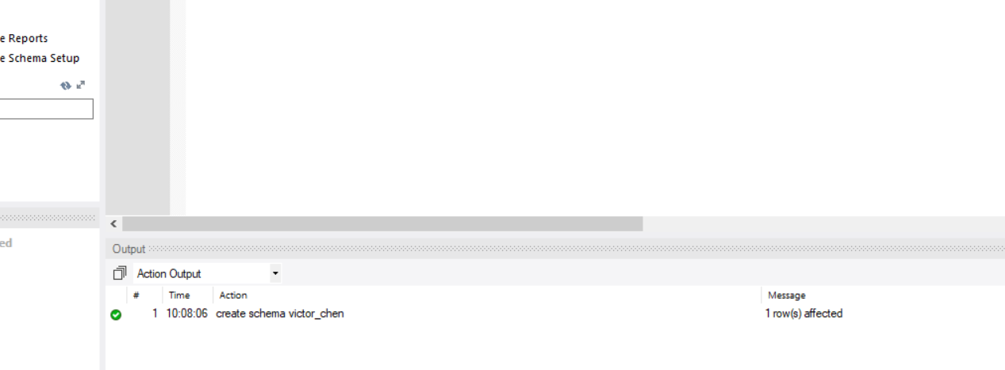
Check Output Window
Command ran successfully

Slide 26
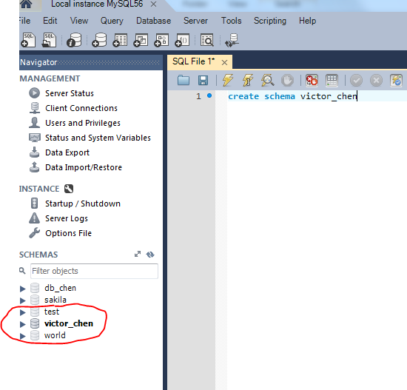
Refresh the left pane to see the result
Notice: you should double-click your new DB to set it as default DB

Slide 27
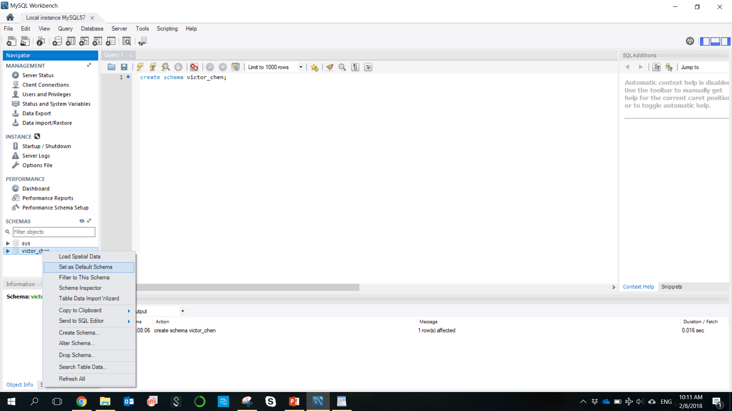
Specify which DB you want to use by setting it as default DB

Slide 28
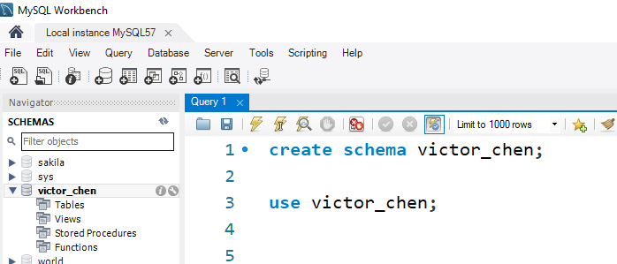
Specify which DB you want to use by setting it as default DB
You can also use command “use db_name”

Slide 29
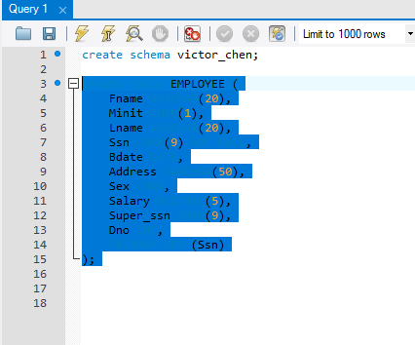
Select the SQL script you want to run and run it
Here we want to create a table EMPLOYEE

Slide 30
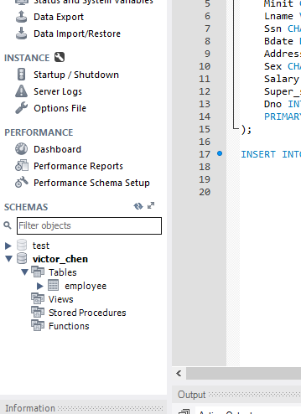
Refresh the left pane and you see the new table show up

Slide 31
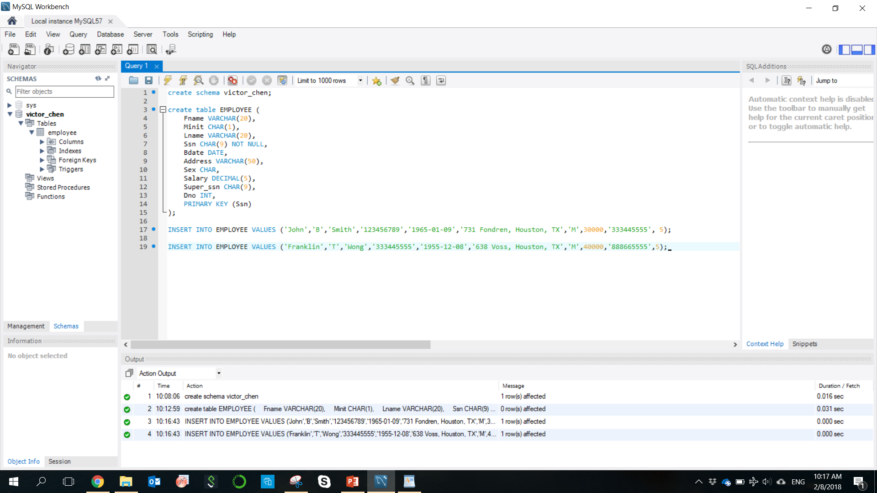
Insert two tuples to table EMPLOYEE

Slide 32
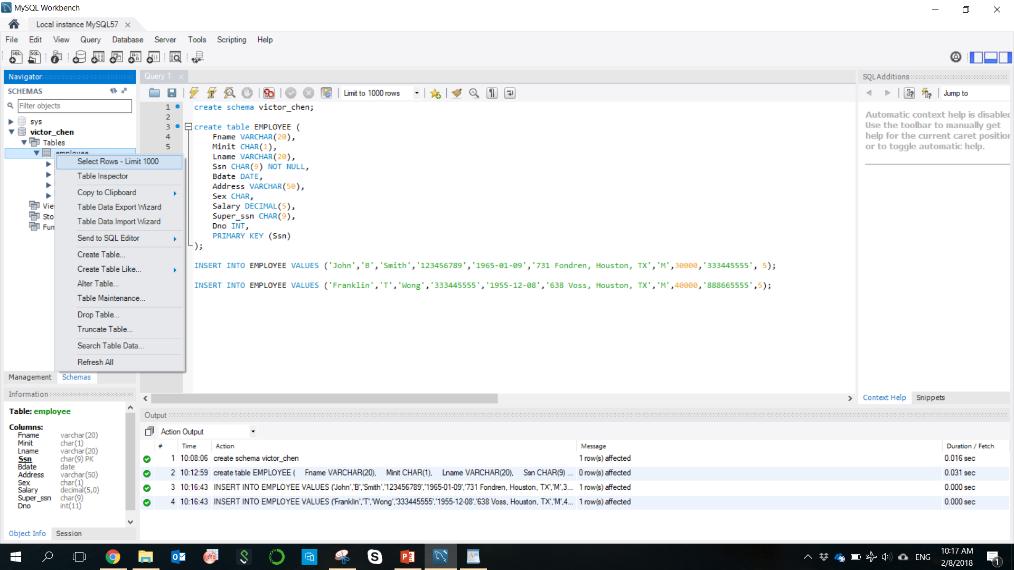
Check Current Table Content
Right click the table in the left pane and select “select rows – Limit 1000”.
Or simply run “select * from Employee”

Slide 33
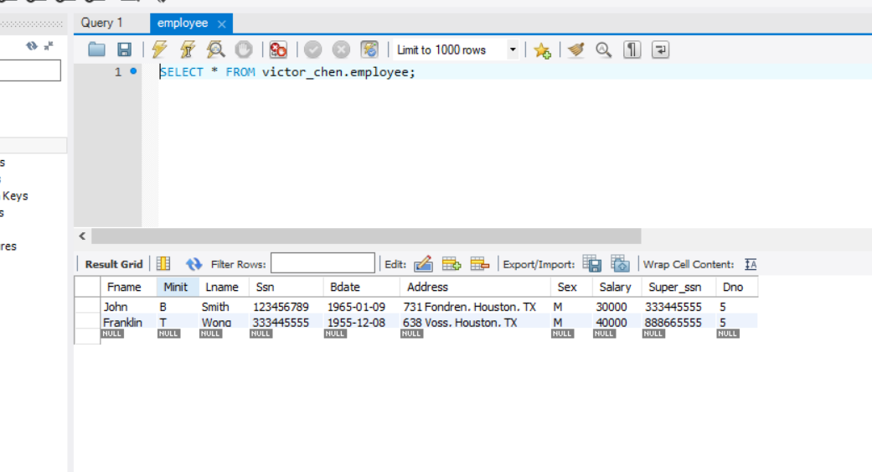
Tuples Returned…

Slide 34
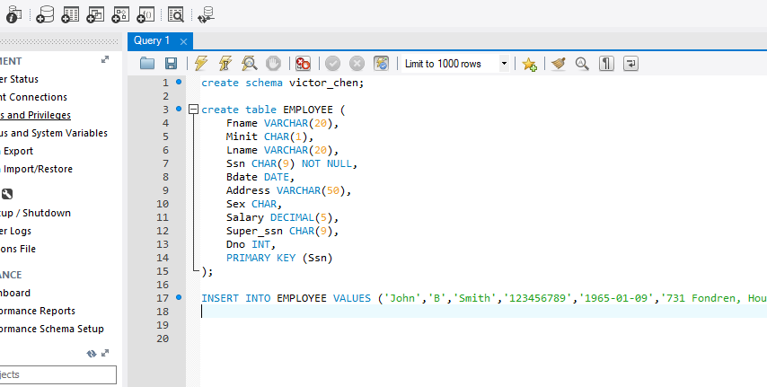
To save your script, click save button to save it as SQL file

Slide 35
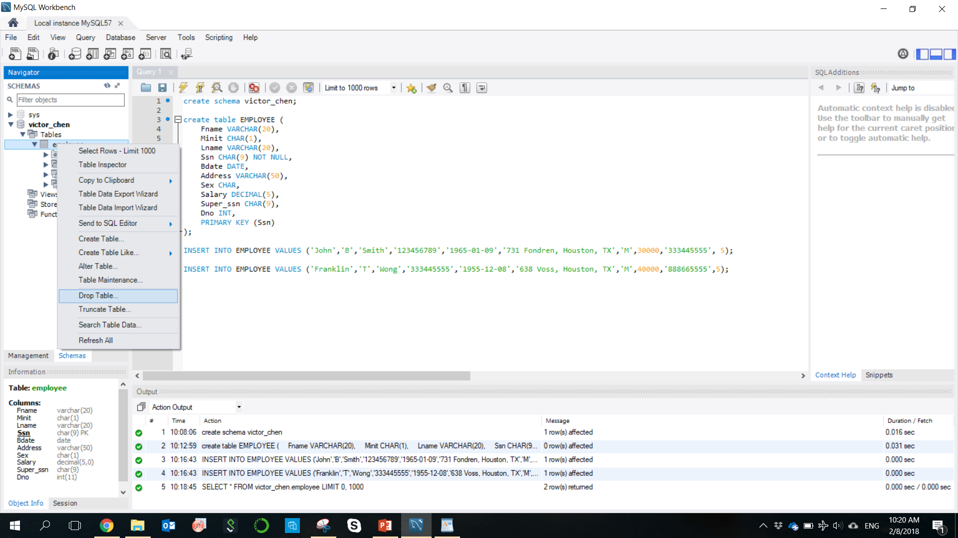
Drop a table (so you can re-create it)
Right click the table in the left pane and select “Drop Table”

Slide 36
Drop a table using SQL
DROP TABLE table_name;

Slide 37
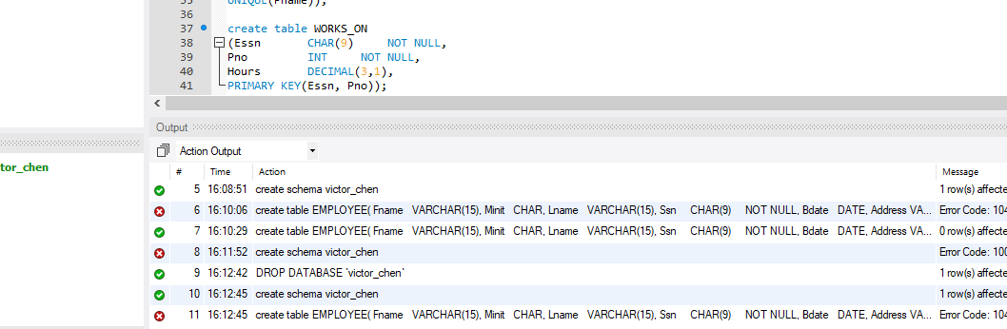
What if my script does not run?
Go to Action Output Window at the bottom and read the error message

Slide 38
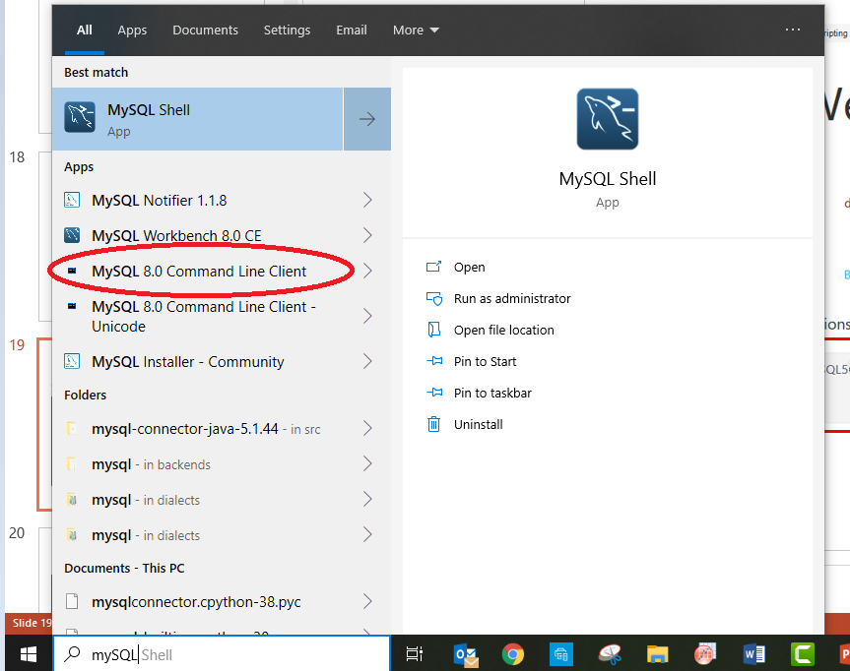
Talk to MySQL via Command Line

Slide 39
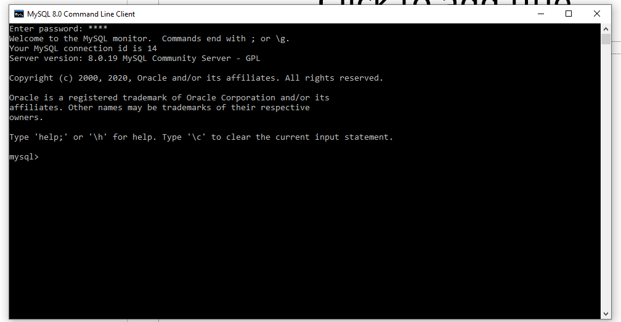
Enter any SQL statements here

Slide 40
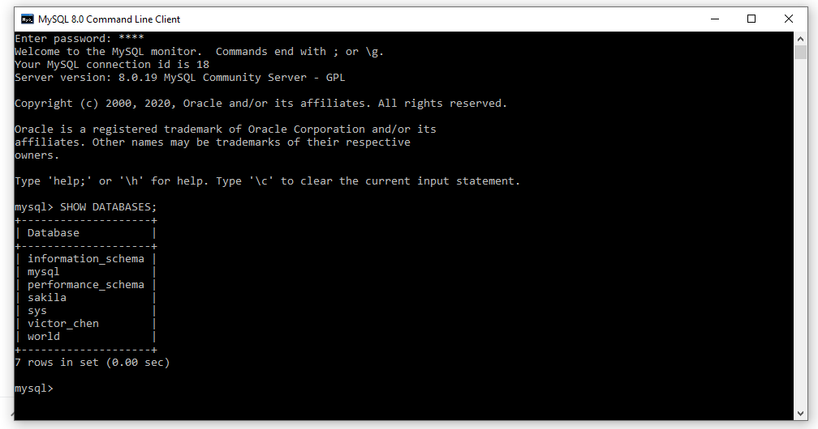
Show databases

